Slide 1
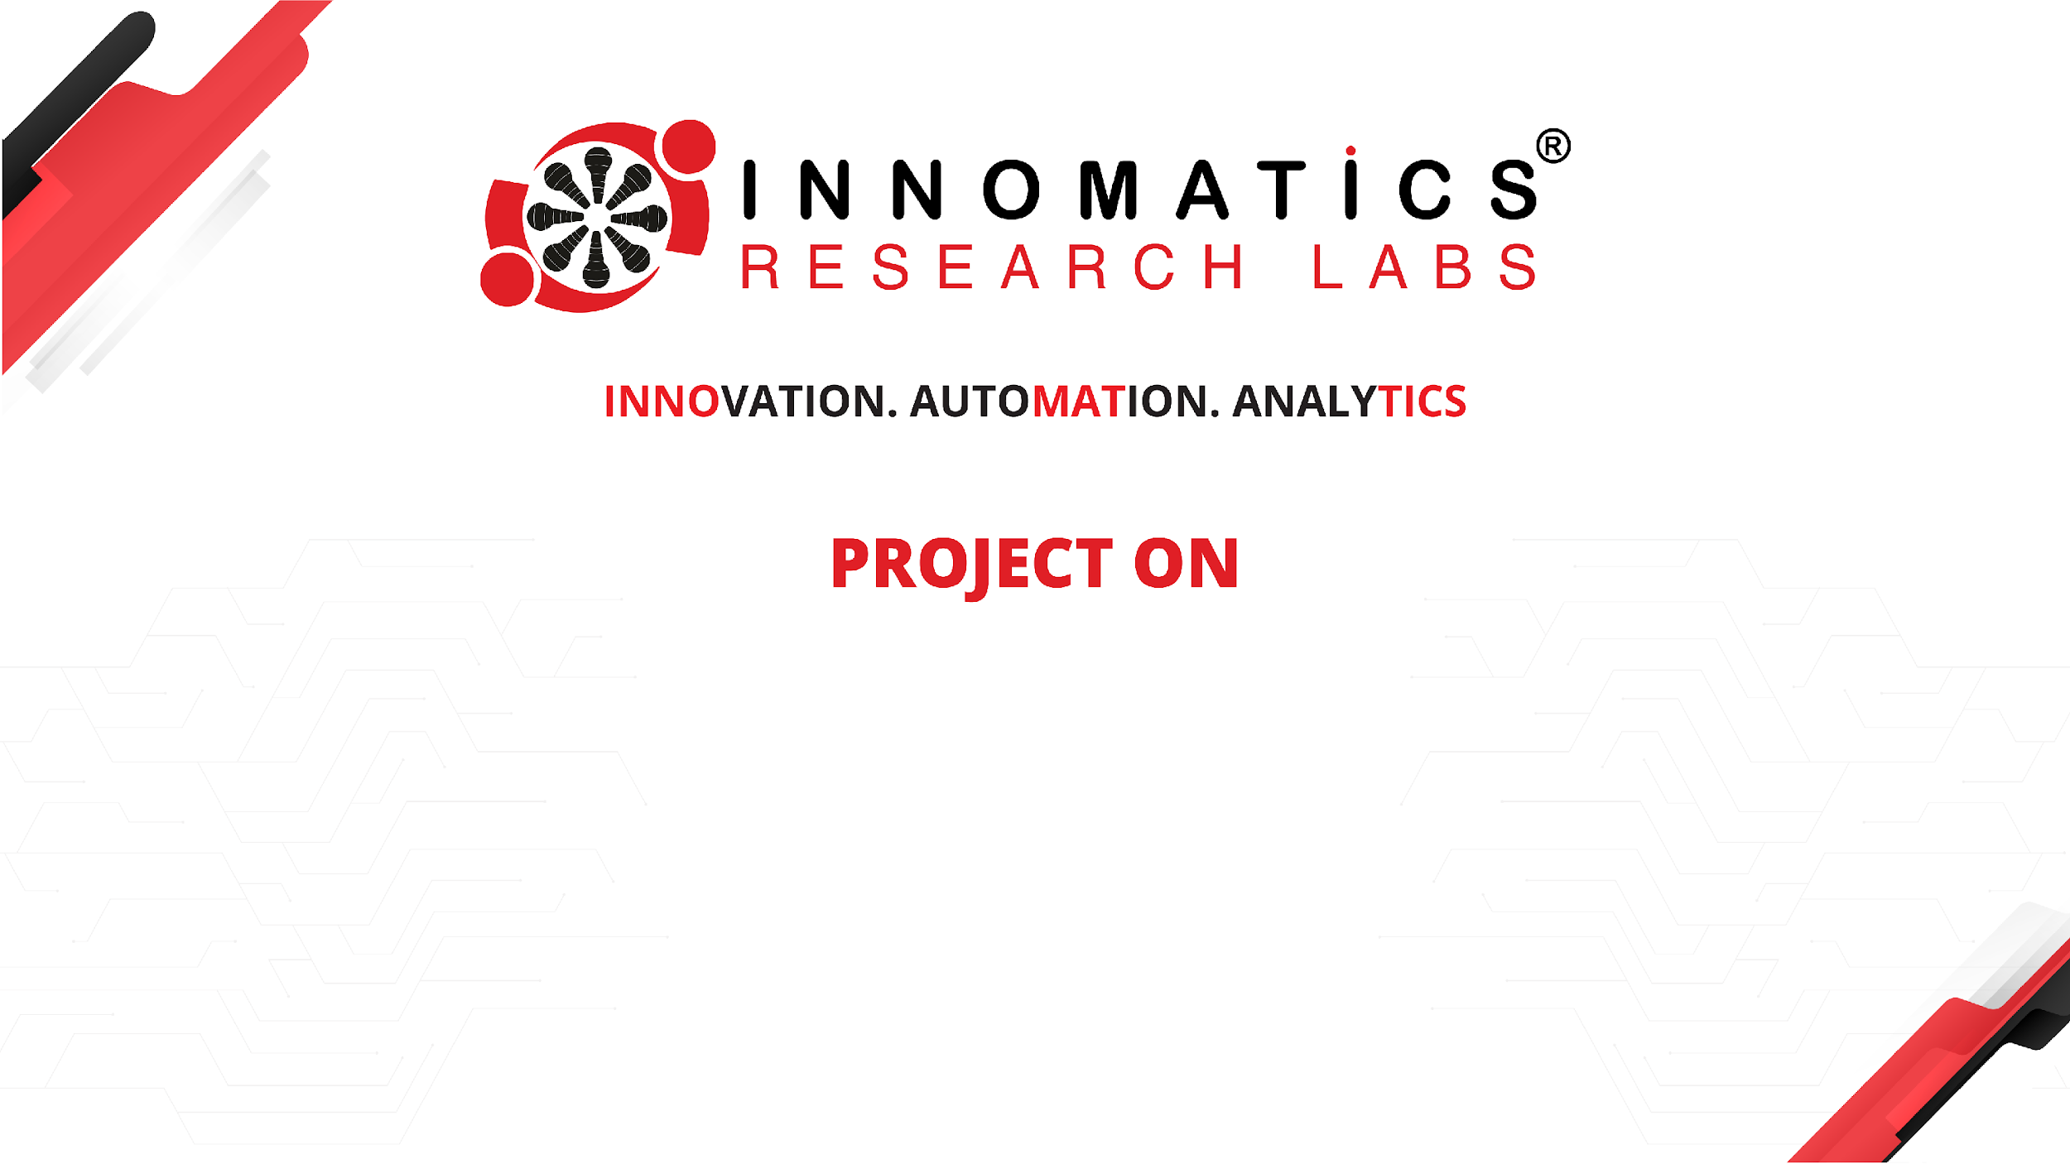
Internship Market Analysis
USING Web Scraping & EDA
Presented By : Pavani Jambuluri Batch No : 546
Branch : Dilsuknagar

Slide 2
About Me :
I have completed my B.Tech in Electrical and Electronics Engineering (EEE) from Annamacharya University.
I am interested in exploring data and how can we understand what is happening and how it can be used to solve real-world problems, this motivated me to develop my skills in Data Analytics and to build a career in the IT industry.
You can connect with me through my LinkedIn and GitHub profiles :
LinkedIn : https://www.linkedin.com/in/pavani-jambuluri-9617b5320
GitHub : https://github.com/Pavani-7036

Slide 3
Agenda :
✓Business Problem
✓ Problem statement
✓ Introduction
✓ Data Collection
✓ Data Description
✓ Data Cleaning & Preprocessing
✓ Testing
✓ Data Visualization & Insights
✓ Future Enhancements
✓ Conclusion

Slide 4
Business Problem :
Internship opportunities are available across different profiles, locations, work modes, stipends, and durations. However, comparing these opportunities and understanding overall internship trends can be challenging without well-organized data. Applicants often find it difficult to compare internship opportunities across different companies, locations, stipend ranges, and skill requirements.

Slide 5
Problem Statement :
Web scraping was used to collect internship data from Internshala using Selenium and BeautifulSoup. The collected data was cleaned and analyzed using Python, Pandas, and visualization libraries to identify patterns in stipends, locations, work modes, required skills, companies, and internship durations. These insights help applicants compare opportunities and make informed internship decisions.

Slide 6
Introduction:
Internshala is a online platform that provides internship opportunities across various domains and industries. Internship listings offer valuable information about the current internship market, including available roles and the skills employers look for. This project explores the internship market to gain a clearer understanding of the opportunities and to identify the trends reflected in the collected data.

Slide 7
Data Collection :
For data collection, I used Selenium and BeautifulSoup with Python. Selenium helped me access the webpage, while BeautifulSoup helped extract the required information from its HTML structure. The internship data was collected from Internshala and organized into a structured Pandas DataFrame containing 610 internship records. The dataset includes details such as internship title, company, location, stipend, duration, skills, and posting information.

Slide 8
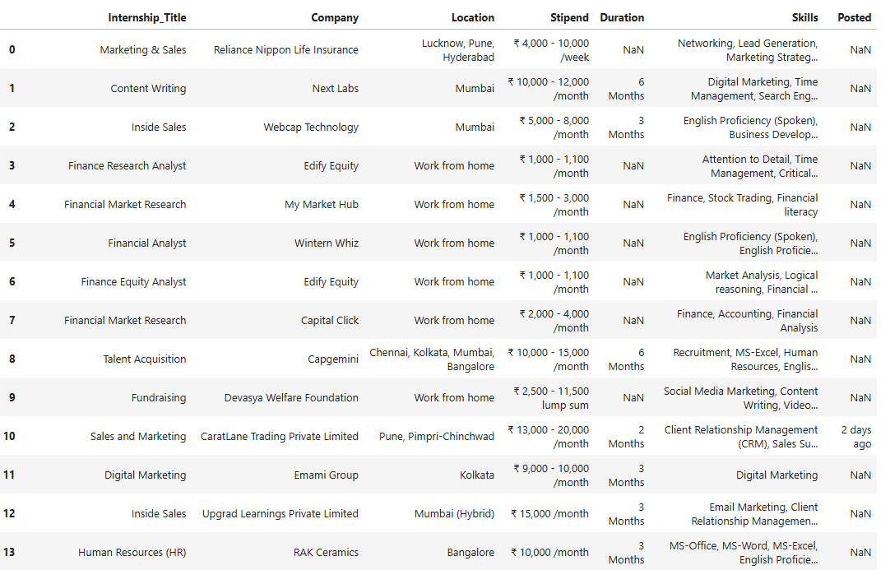
Sample of the collected dataset

Slide 9
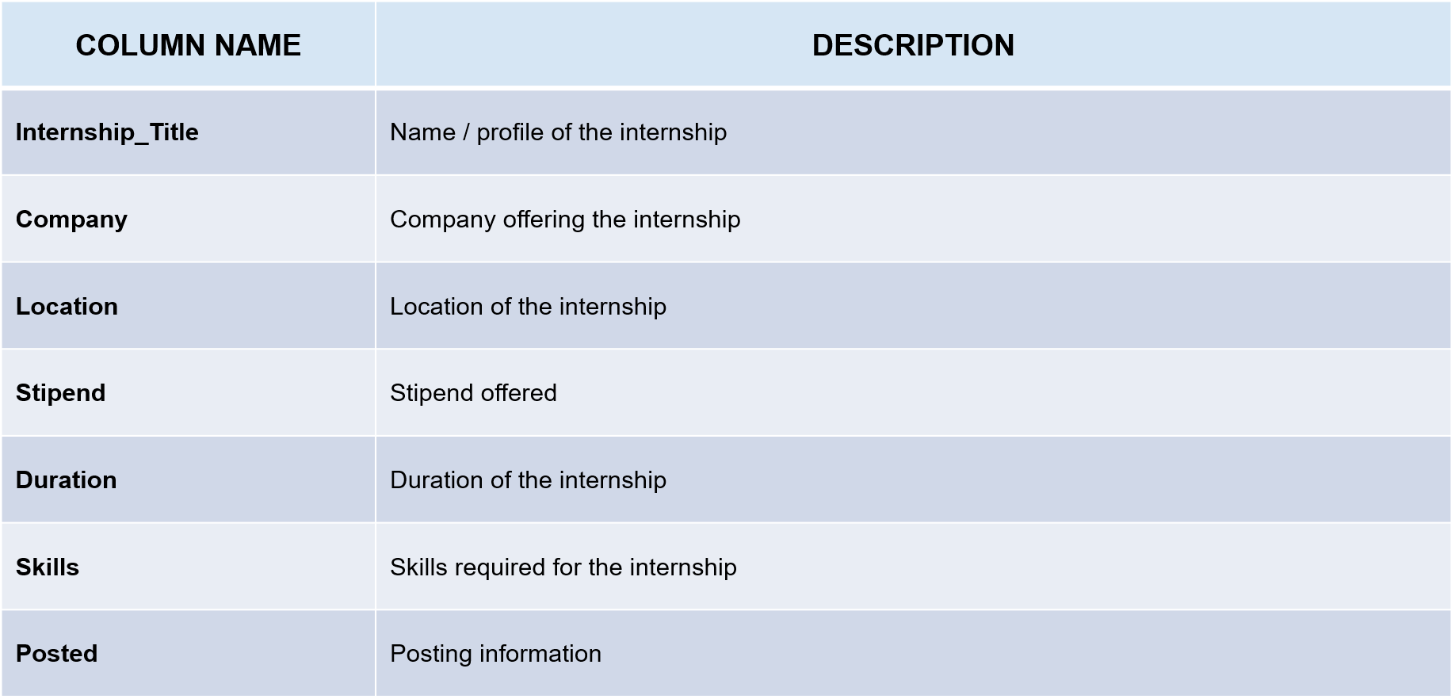
Data Description
The collected dataset contains 610 internship records with 7 attributes describing each internship opportunity.

Slide 10
Data Cleaning & Preprocessing
The collected data was checked and prepared before analysis. Missing values were checked and identified, particularly in the Duration and Posted columns. The dataset structure and data types were also verified to ensure the data was ready for further analysis.
Key Steps:
Handling Missing Value
Remove Duplicates
Data Type Correction
Outlier Detection
Text Cleaning

Slide 11
Hypothesis Testing :
1. T -Test
I selected the t-test because my objective was to compare the sample's average stipend with a single reference value.
To check whether the average internship stipend differs significantly from the ₹10,000 reference value.
H₀ (Null Hypothesis): The average internship stipend is equal to ₹10,000.
H₁ (Alternative Hypothesis): The average internship stipend is different from ₹10,000.
T-statistic: 6.56 > T-critical: 1.964, so it rejects the null hypothesis.
2. Chi-Square Test
To check whether internship work mode is associated with internship duration.
H₀ (Null Hypothesis): There is no significant association between work mode and internship duration.
H₁ (Alternative Hypothesis): There is a significant association between work mode and internship duration.
The T-test identified a difference in average stipend compared with the reference value, while the Chi-square test identified an association between work mode and duration.
.

Slide 12
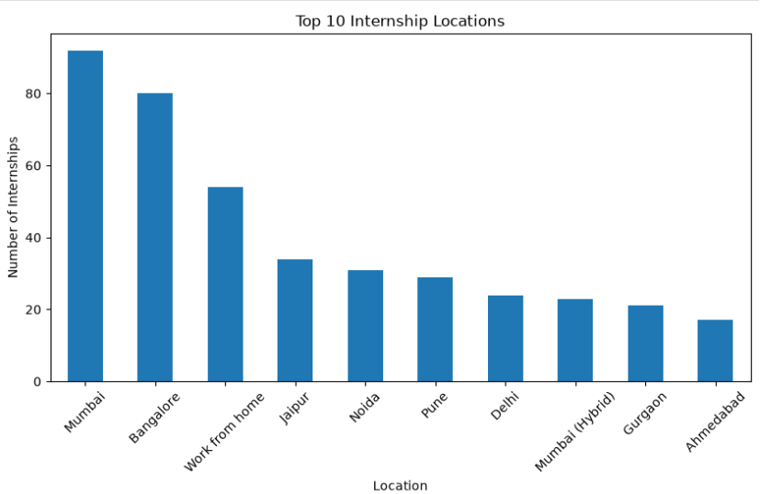
Data Visualization
The data was analyzed using different visualizations to understand key trends and patterns. These charts highlight insights related to locations, companies, skills, internship duration, and stipends.
1. Internship Distribution by Location
Insight: “Most internship opportunities in the dataset are concentrated in Mumbai, followed by Bangalore. This indicates that these cities have more internship listings in the collected data.”

Slide 13
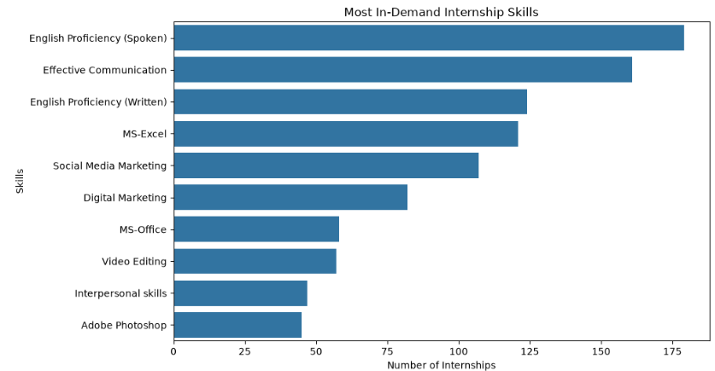
2. Most- In Demand Skills
Insight : “English Proficiency (Spoken) is the most frequently mentioned skill, followed by Effective Communication and English Proficiency (Written).”

Slide 14
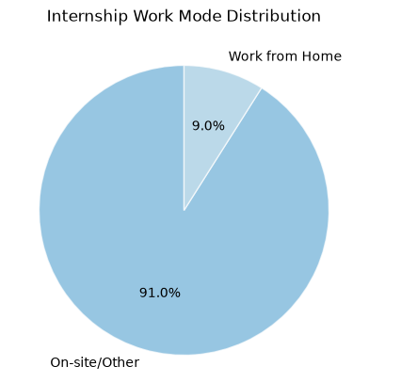
3. Internship Work Mode Distribution
Insight: Most internship listings are for on-site or other locations, while work-from-home opportunities form a smaller share.

Slide 15
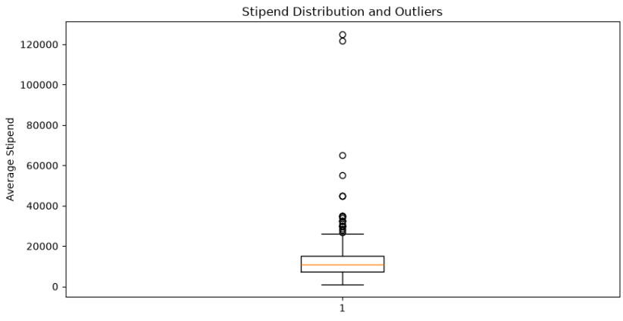
4. Stipend Outlier Analysis
Insight : “Most internships offer stipends within a common range, while a few internships have unusually high stipend values compared to the others.”

Slide 16
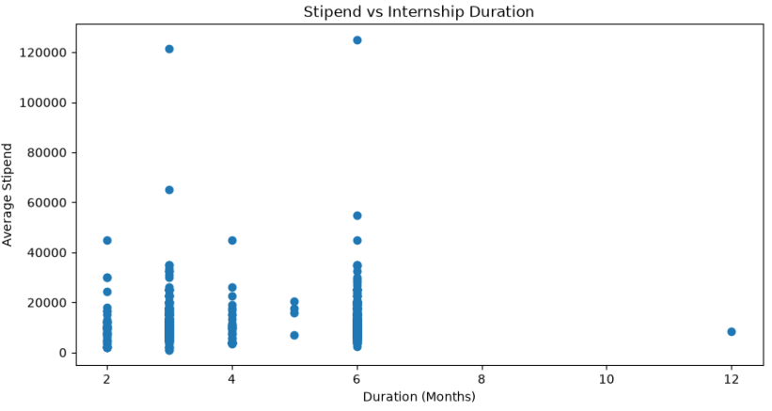
5. Stipend vs Internship Duration
Insight : Stipend values vary across different internship durations, with no clear direct relationship.

Slide 17
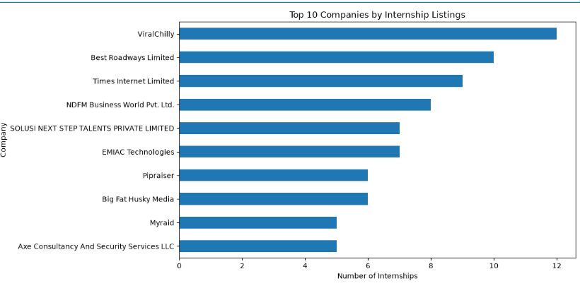
6. Top Companies by Internship Listings
Insight : ViralChilly has the highest number of internship listings among the top 10 companies, followed by Best Roadways Limited. This indicates that internship opportunities are concentrated more heavily in a few companies within the collected dataset.

Slide 18
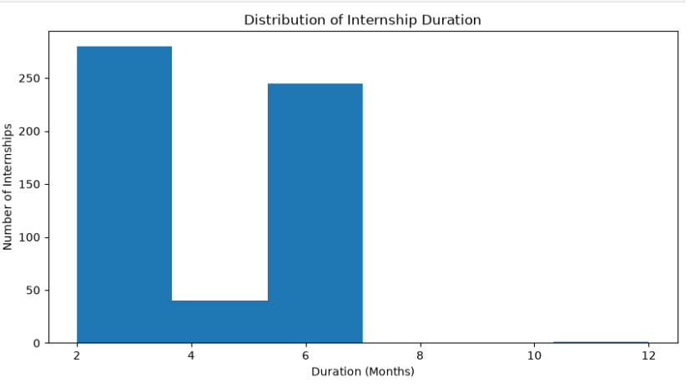
7. Internship Duration Distribution
Insight : Most internships are concentrated around a few common durations, especially 3 and 6 months.

Slide 19
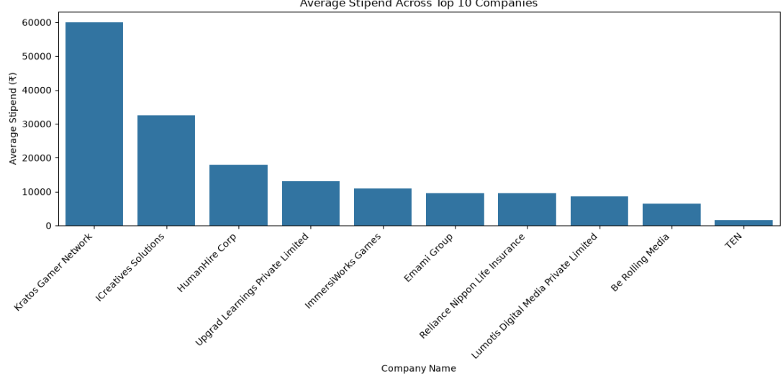
8. Company vs Stipend¶
Insights:The average stipend varies across companies, showing that internship compensation is not the same everywhere. This helps applicants compare stipend offerings and shortlist opportunities based on their preferences and expectations.

Slide 20
Future Enhancements :
Stipend Prediction: Use Machine Learning to predict internship stipends based on available data.
AI-Based Recommendations: Suggest suitable internships based on students’ skills and interests.
Skill Prediction: Use Machine Learning to identify skills that may be in demand in the future.
AI-Based Search: Help students find relevant internships using their preferred skills, location, and stipend.
5. Power BI Dashboard: Develop an interactive Power BI dashboard to visualize internship trends, compare stipends, analyze locations, and explore in-demand skills.

Slide 21
Conclusion:
This project helped me understand how web scraping and data analytics can be applied to a real-world problem. I worked through different stages, starting with data collection and preparation, followed by exploratory analysis, visualization, and statistical testing. Through the charts, I explored patterns in internship locations, skills, durations, companies, and stipends. Overall, the project shows how web scraping and data analytics can turn raw internship data into useful insights, making it easier to understand internship opportunities and the skills expected from candidates.

Slide 22


Slide 23

THANK YOU

